Slide 1
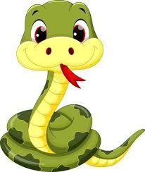

s
a
Snake
Apple

Slide 2
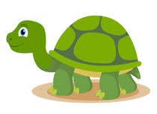
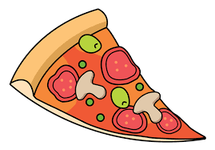
t
p
Turtle
Pizza

Slide 3

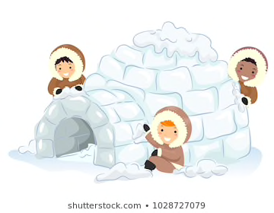
n
i
Nose
Igloo

Slide 4
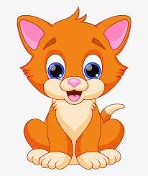

c
k
Cat
Kite

Slide 5
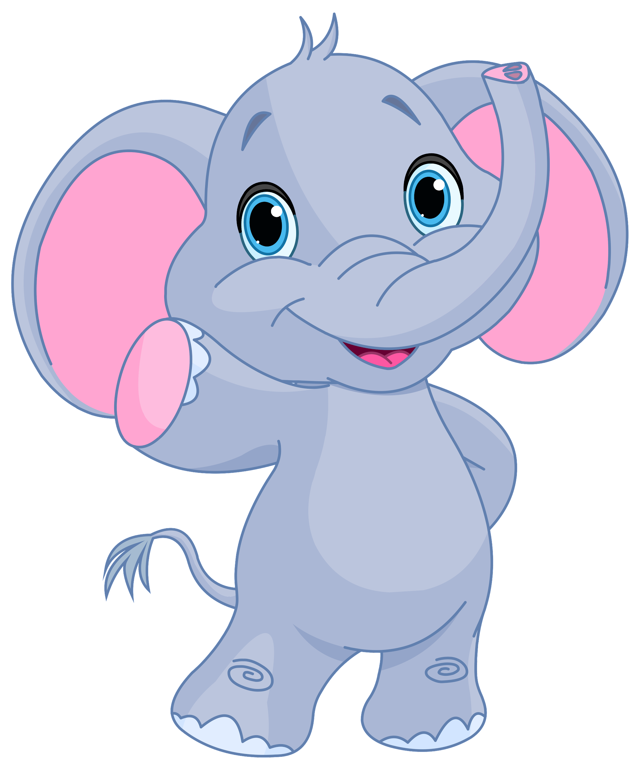
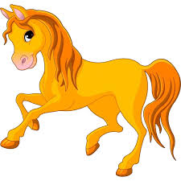
e
h
Elephant
Horse

Slide 6
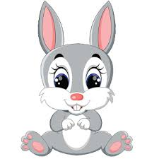

r
m
Rabbit
Mud

Slide 7
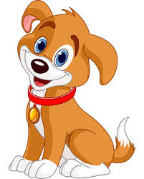
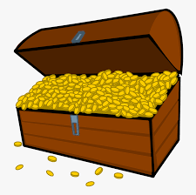
d
g
Dog
Gold

Slide 8


o
u
Owl
Umbrella

Slide 9
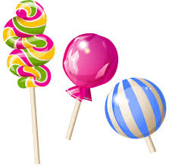

l
f
Lollipop
Fish

Slide 10

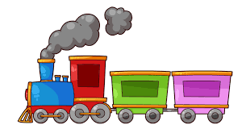
b
ai
Balloon
Train

Slide 11

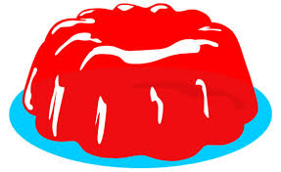
j
oa
Jelly
Boat

Slide 12


ie
ee
Pie
Bee

Slide 13
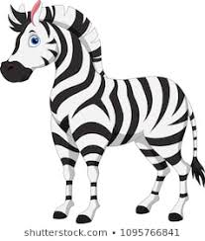
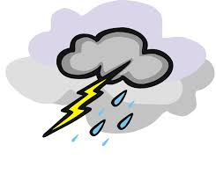
or
z
Storm
Zebra

Slide 14

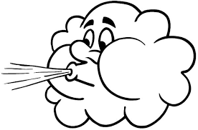
w
ng
Wind
Sing

Slide 15


v
oo
Violin
Look

Slide 16


00
y
Book
Yellow

Slide 17


x
ch
Fox
Chair

Slide 18


sh
th
Shell
Earth

Slide 19

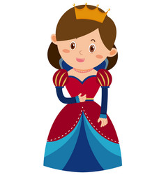
th
qu
Think
Queen

Slide 20
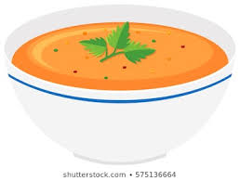
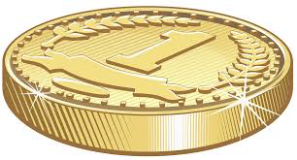
ou
oi
Soup
Coin

Slide 21

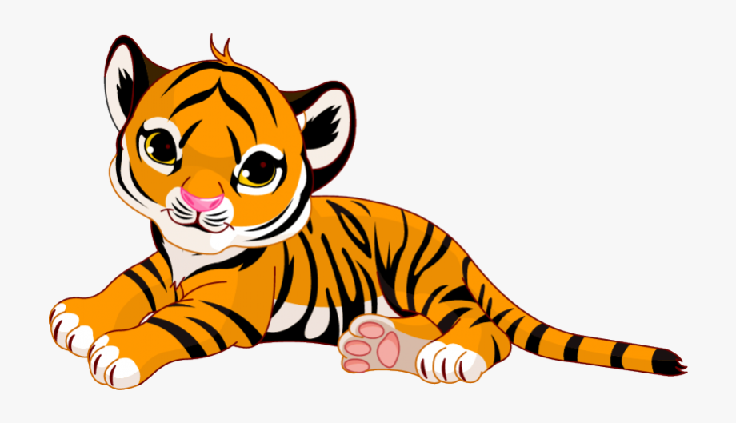
ue
er
Tissue
Tiger

Slide 22

ar
Car

